Slide 1
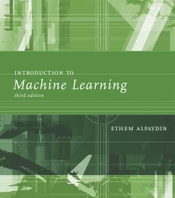
INTRODUCTION TO Machine Learning 3rd Edition
Lecture Slides for
ETHEM ALPAYDIN
© The MIT Press, 2014
alpaydin@boun.edu.tr
http://www.cmpe.boun.edu.tr/~ethem/i2ml3e

Slide 2
CHAPTER 17: Combining Multiple Learners

Slide 3
Rationale
No Free Lunch Theorem: There is no algorithm that is always the most accurate
Generate a group of base-learners which when combined has higher accuracy
Different learners use different
Algorithms
Hyperparameters
Representations /Modalities/Views
Training sets
Subproblems
Diversity vs accuracy

Slide 4
Ensembles
Differ in training strategy, and combination method
Parallel training with different training sets
Bagging (bootstrap aggregation) { train separate models on overlapping training sets, average their predictions
Sequential training, iteratively re-weighting training examples so current classier focuses on hard examples: boosting
Parallel training with objective encouraging division of labor: mixture of experts

Slide 5
Variance-bias trade-off
Minimize two sets of errors:
Variance : error from sensitivity to small fluctuations in the training set
Bias : erroneous assumptions in the model

Slide 6
Why ensemble?
Variance reduction : if the training sets are completely independent, it will always help to average an ensemble because this will reduce variance without affecting bias (e.g., bagging)
reduce sensitivity to individual data points
Bias reduction : for simple models, average of models has much greater capacity than single model (e.g., hyperplane classifiers, Gaussian densities).
Averaging models can reduce bias substantially by increasing capacity, and control variance by fitting one component at a time (e.g., boosting)

Slide 7
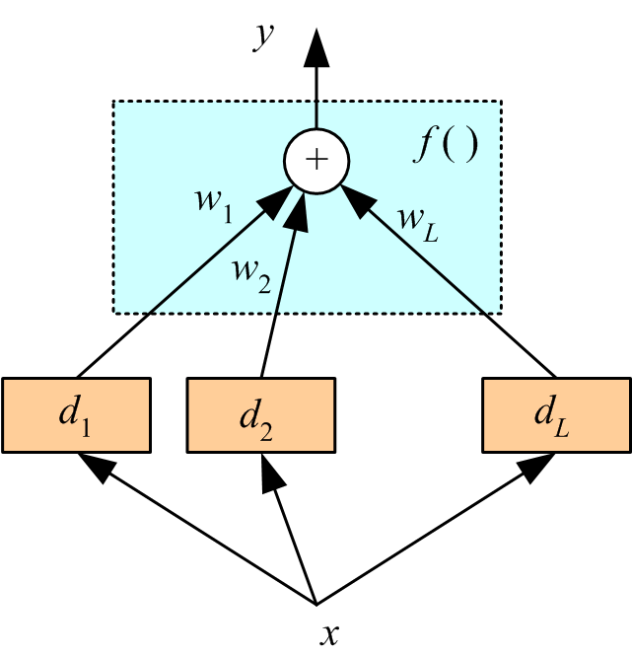
Voting
Linear combination
Classification

Slide 8
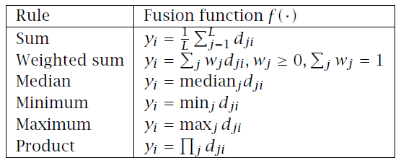
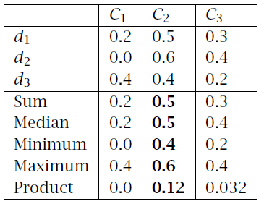
Fixed Combination Rules

Slide 9
Bagging
Use bootstrapping to generate L training sets and train one base-learner with each (Breiman, 1996)
Use voting (Average or median with regression)
Unstable algorithms profit from bagging

Slide 10
Bagging

Slide 11
AdaBoost

Slide 12
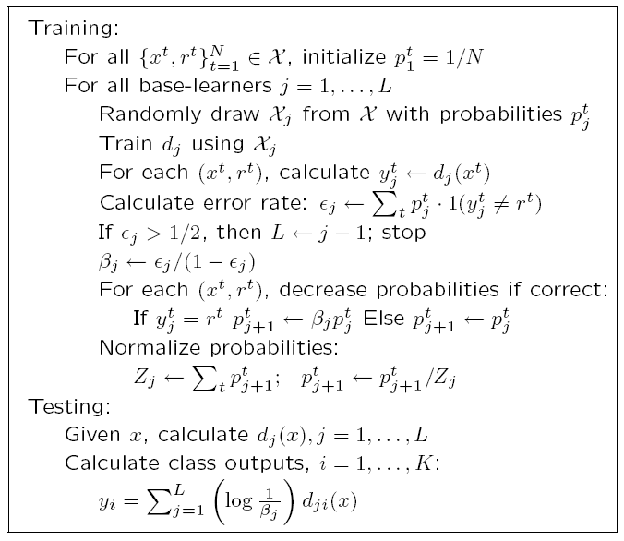
AdaBoost
Generate a sequence of base-learners each focusing on previous one’s errors
(Freund and Schapire, 1996)

Slide 14
Mixture of Experts

Slide 15
Mixture of Experts

